Slide 1
Du reporting avec Moodle Aperçus de ce qui est faisable facilement Moodle 4.4 et 4.3 aussi…
Luiggi Sansonetti

Slide 2
Activités

Slide 3
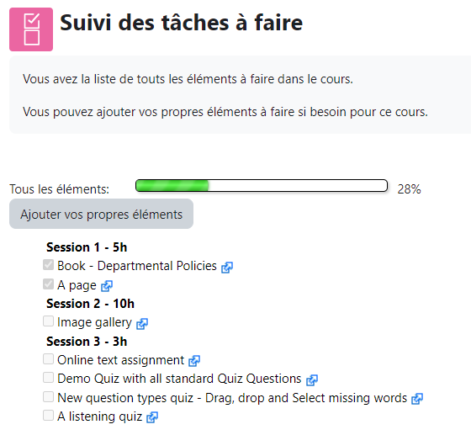
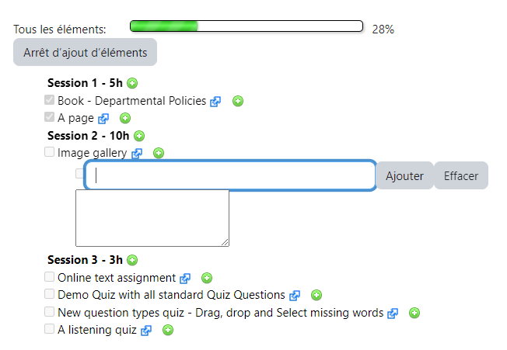
Checklist

Slide 4
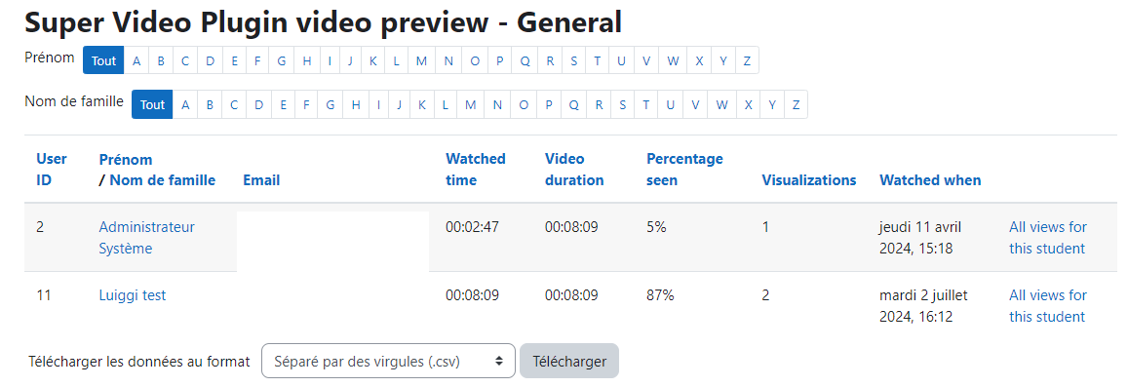
supervideo

Slide 5
Blocs

Slide 6
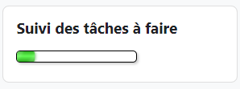
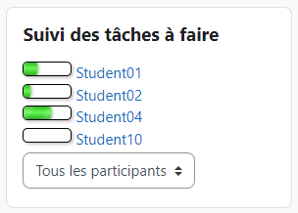
checklist

Slide 7
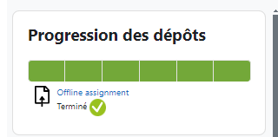
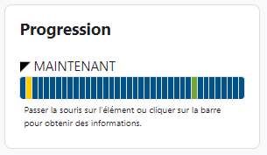
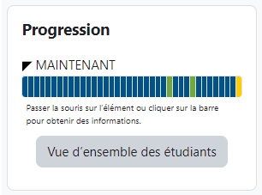
completion progress

Slide 8
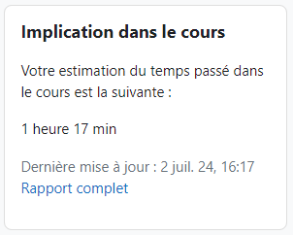
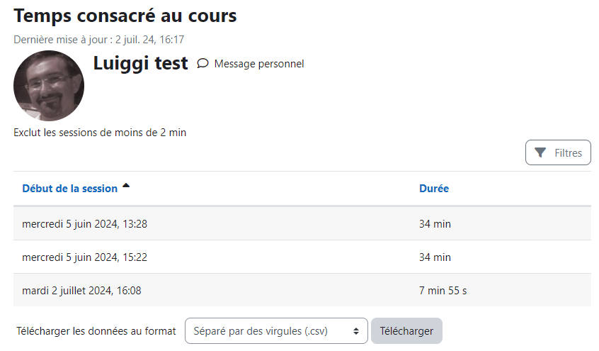
dedication

Slide 9
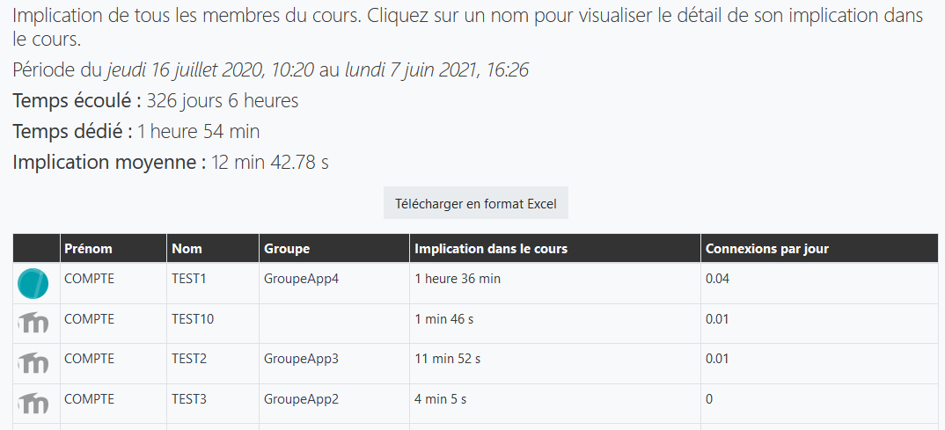
dedication

Slide 10
dedication

Slide 11
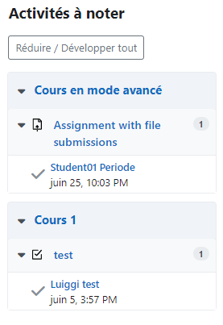
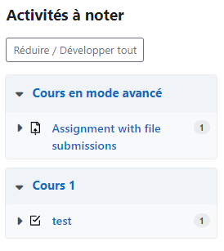
grade me

Slide 12
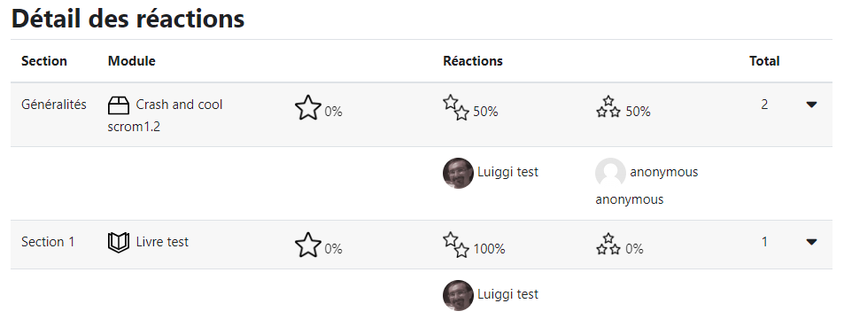
point of view

Slide 13
Rapports

Slide 14
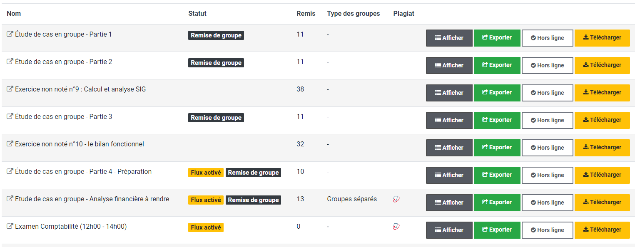
assign

Slide 15
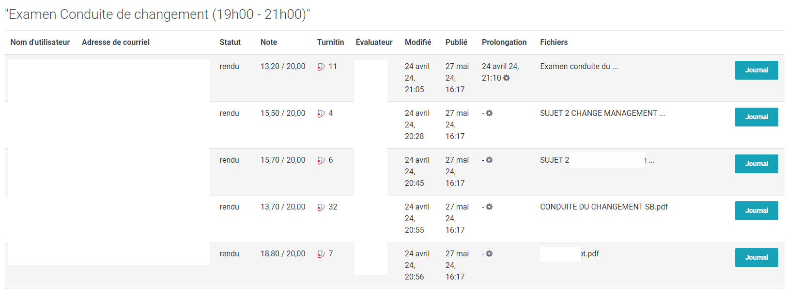
assign

Slide 16
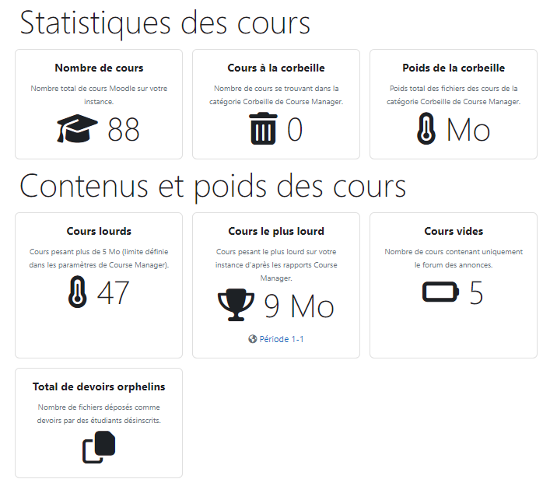
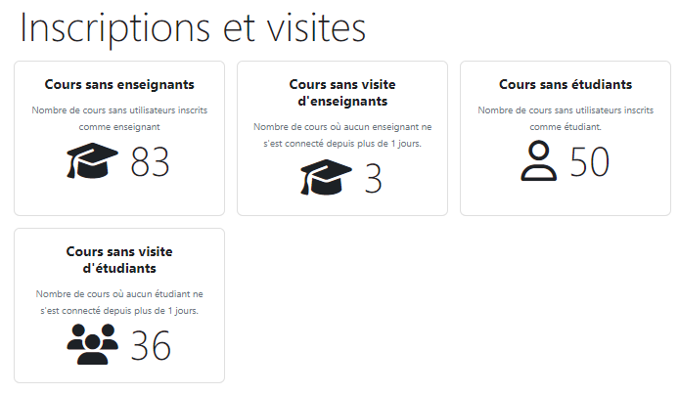
course manager

Slide 17
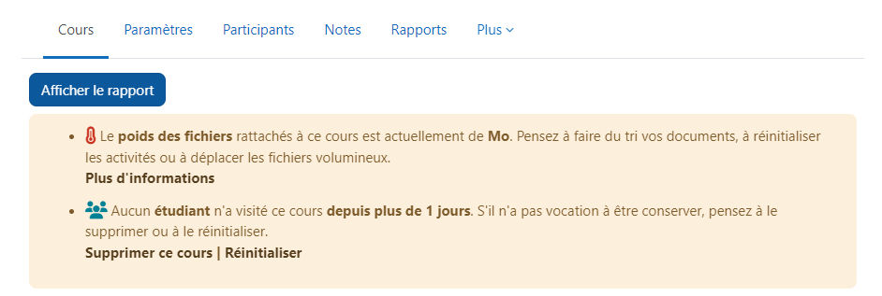
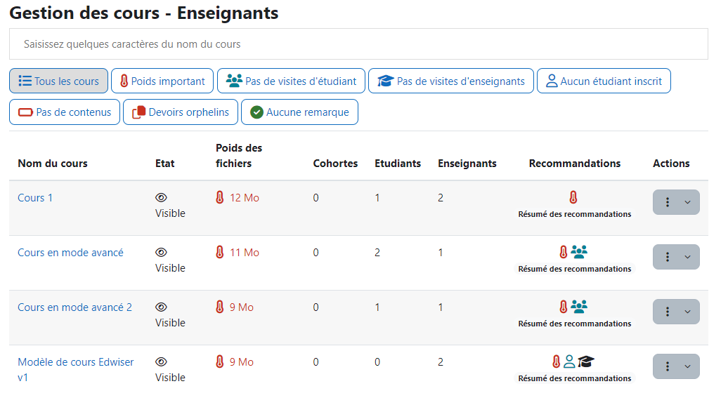
course manager

Slide 18
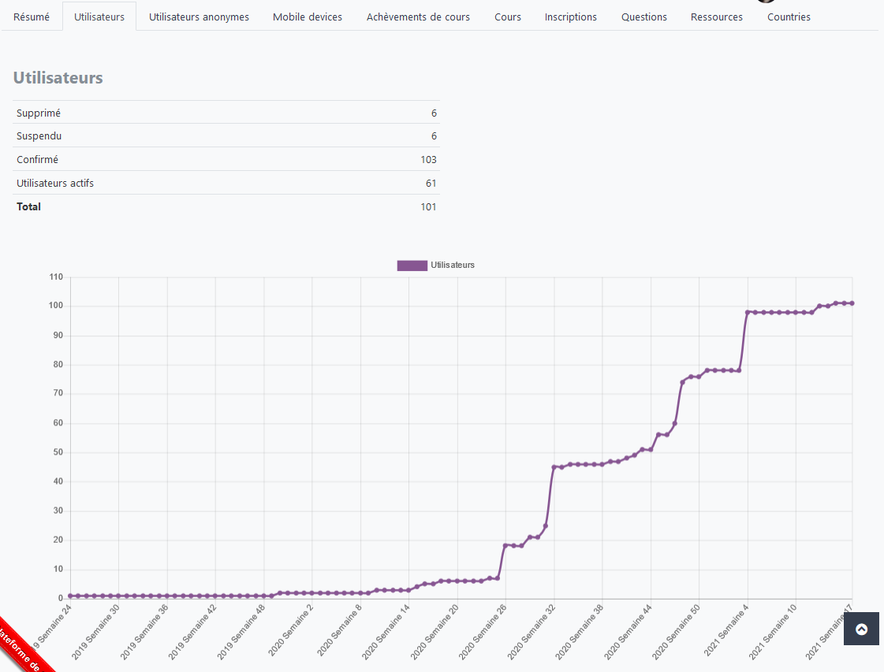
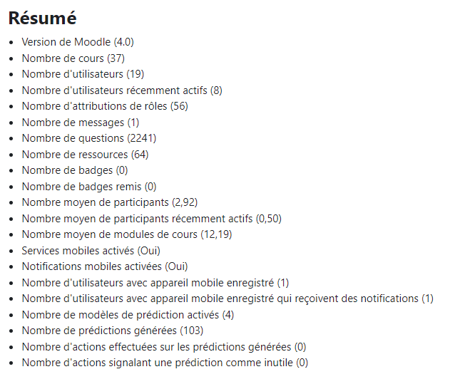
growth

Slide 19
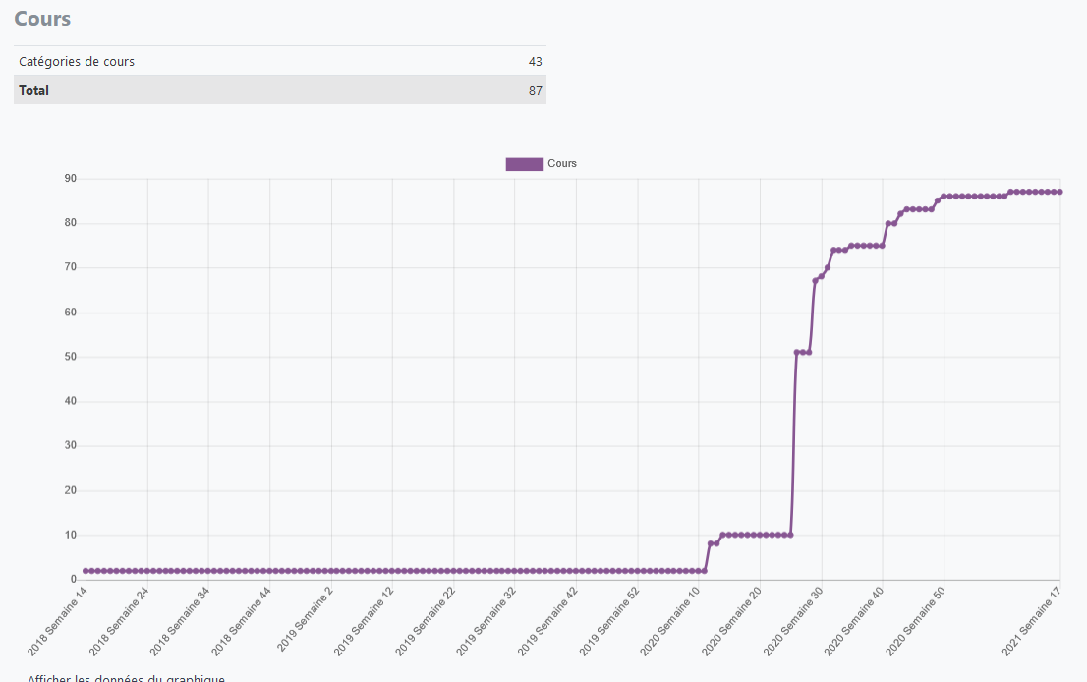
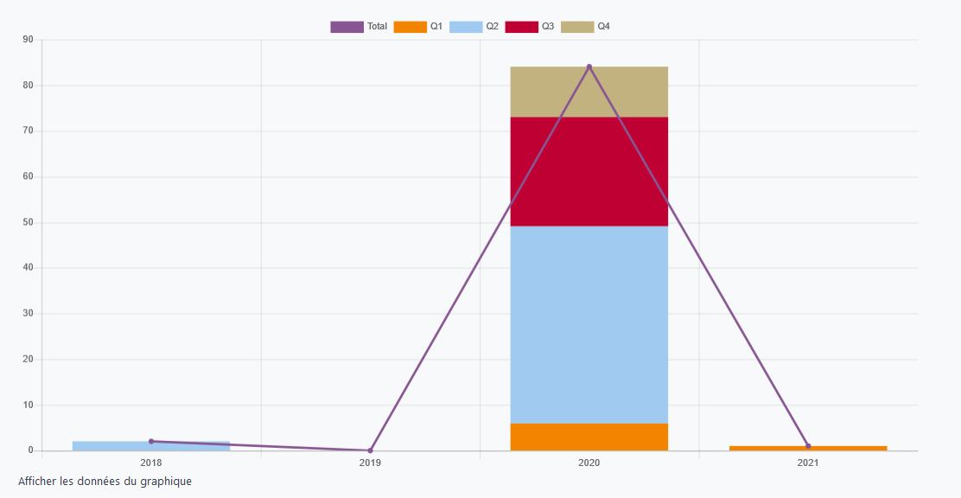
growth

Slide 20
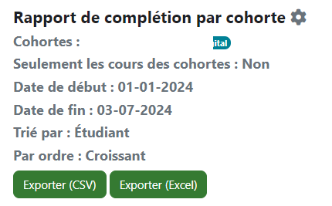
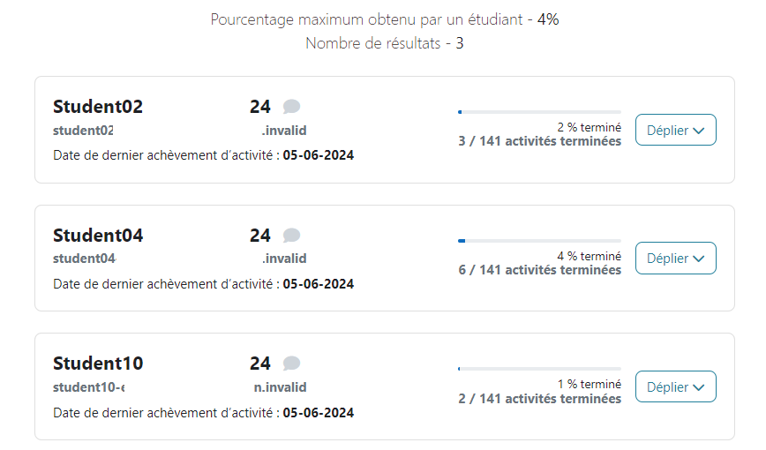
module completion

Slide 21
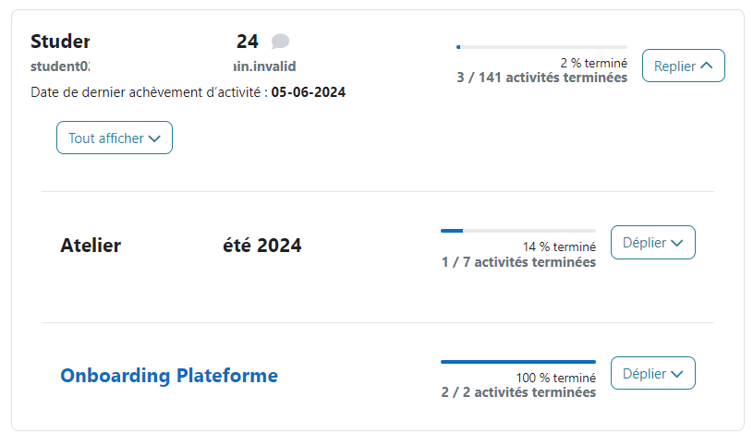
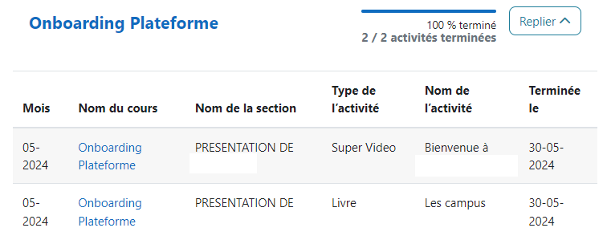
module completion

Slide 22
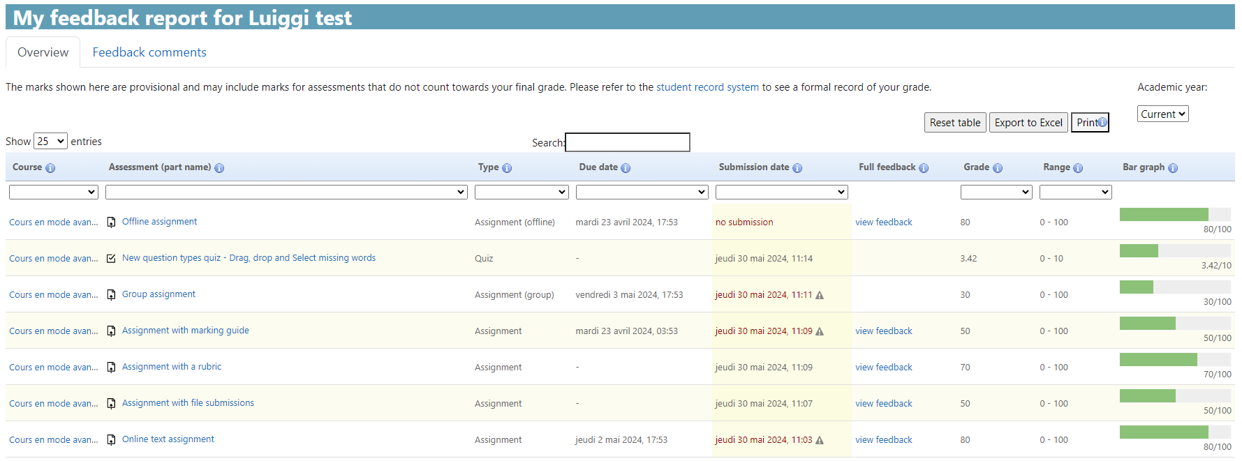
my feedback

Slide 23
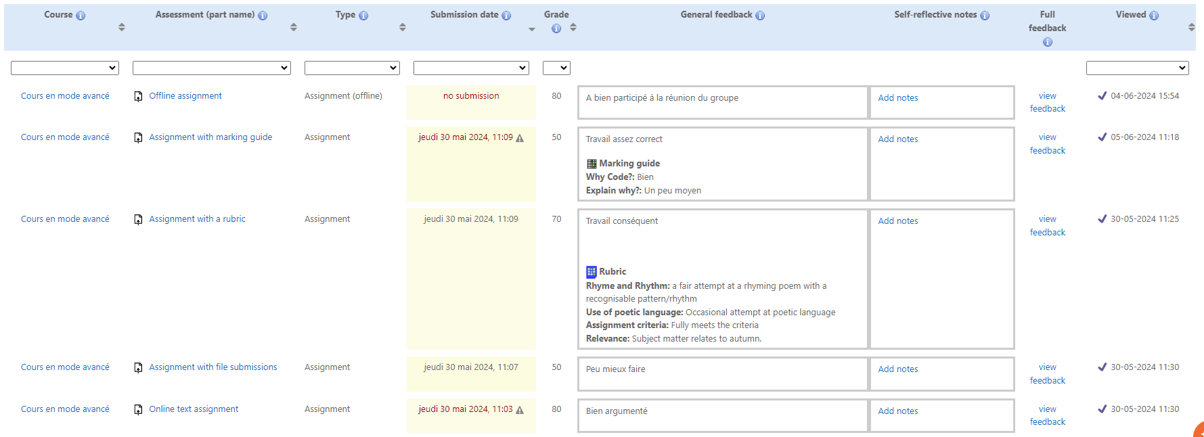
my feedback

Slide 24
my feedback

Slide 25
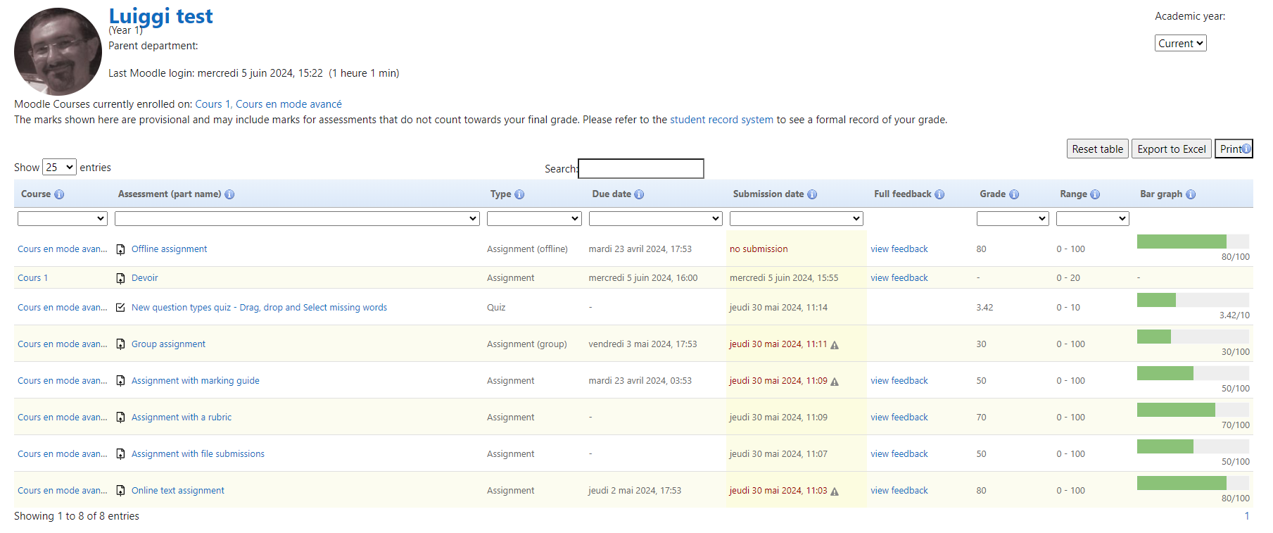
my feedback

Slide 26
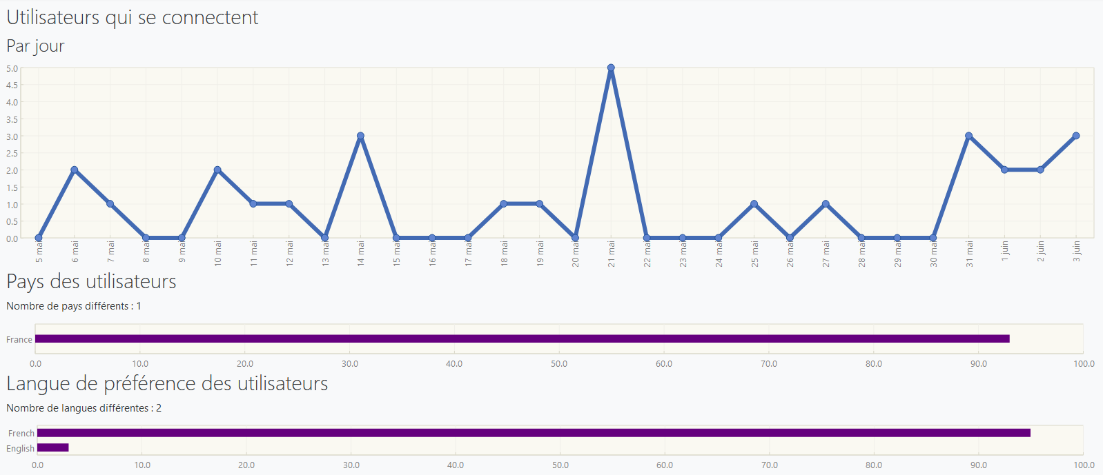
overview statistics

Slide 27
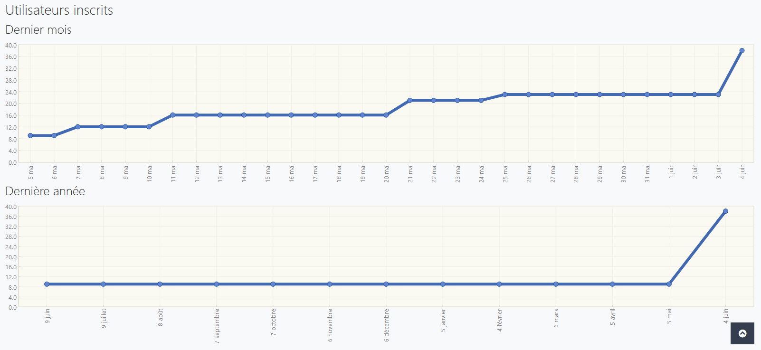
overview statistics

Slide 28
Plugins locaux

Slide 29
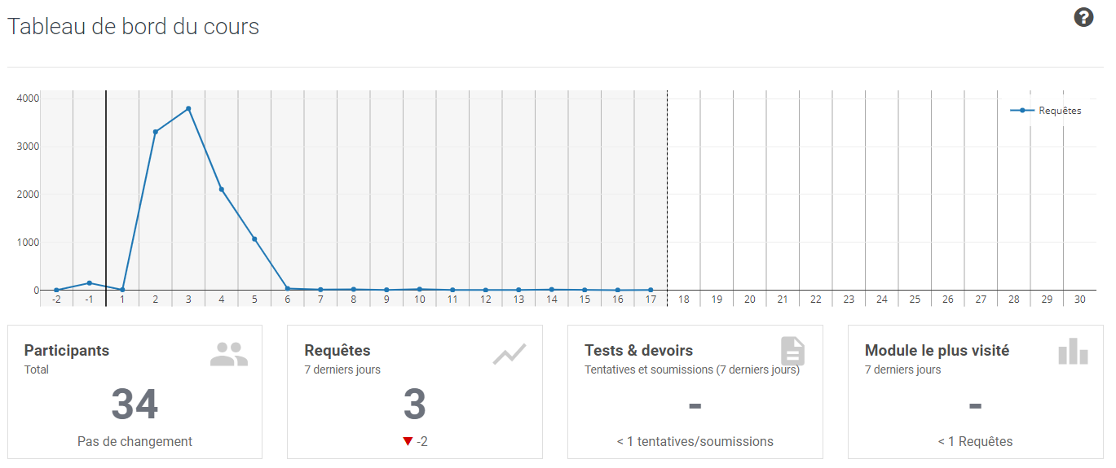
learning analytics

Slide 30
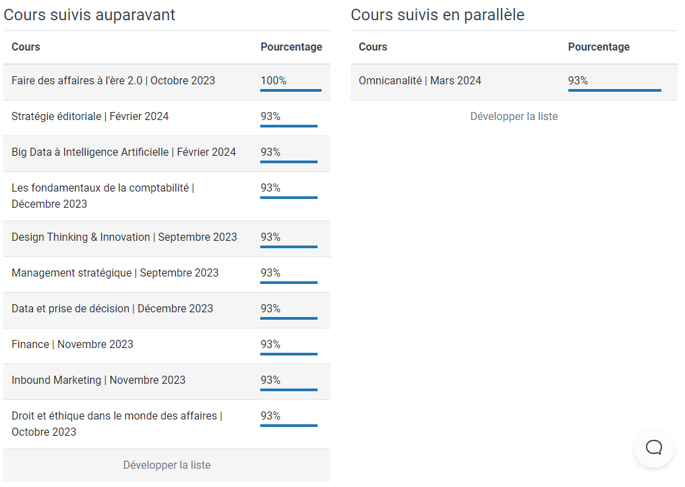
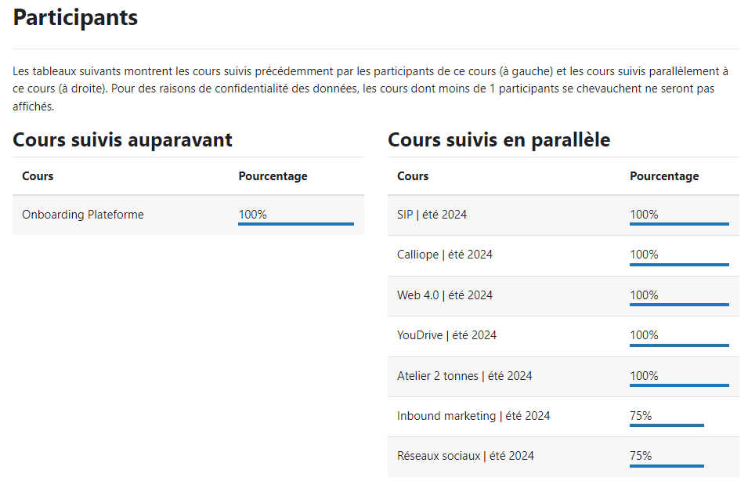
learning analytics

Slide 31
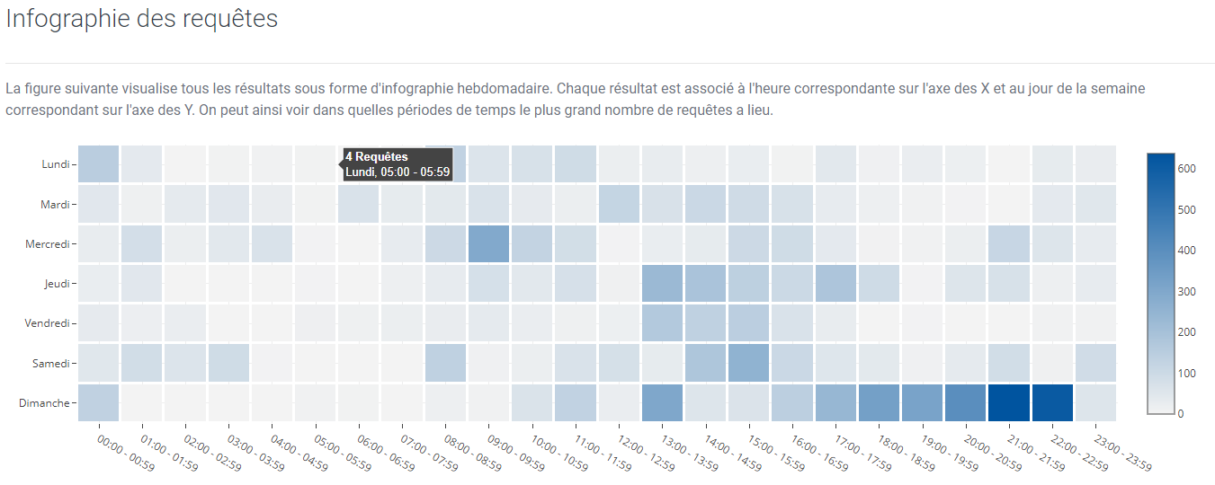
learning analytics

Slide 32
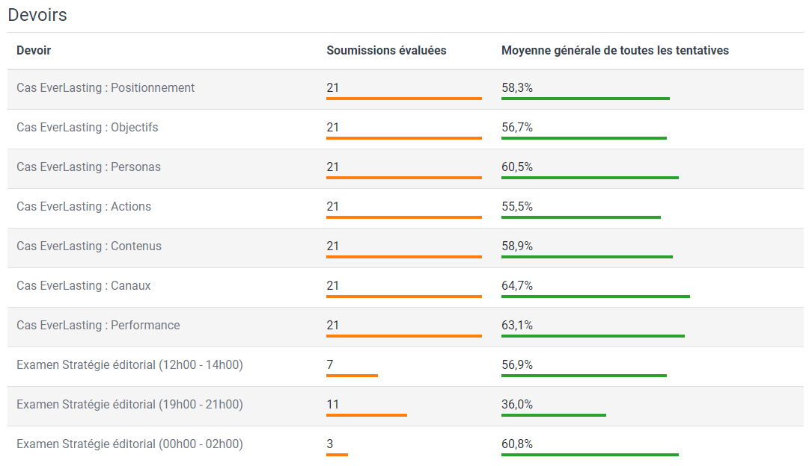
learning analytics

Slide 33
learning analytics

Slide 34
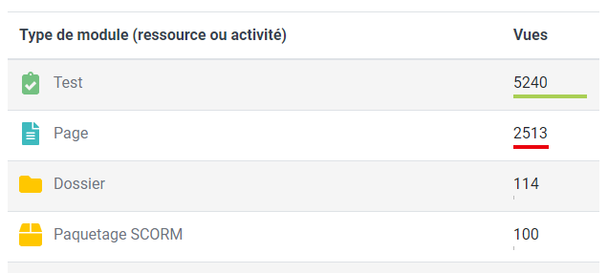
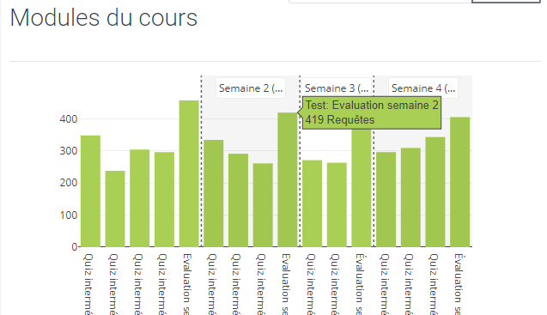
learning analytics

Slide 35
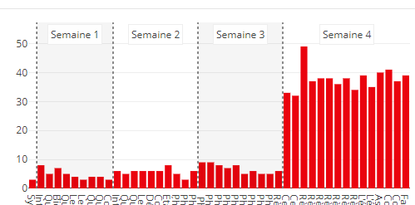
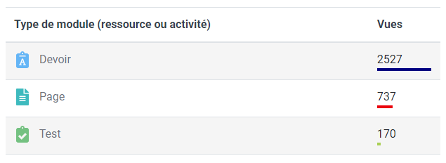
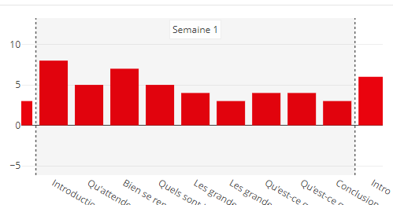
learning analytics

Slide 36
Éléments natifs

Slide 37
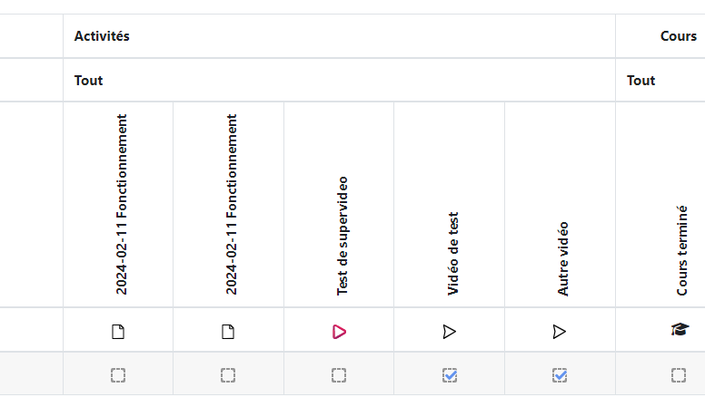
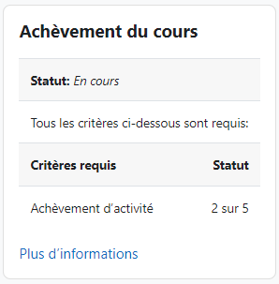
Achèvement de cours

Slide 38
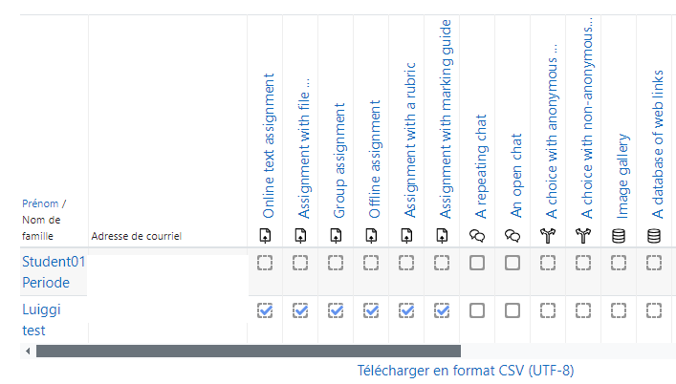
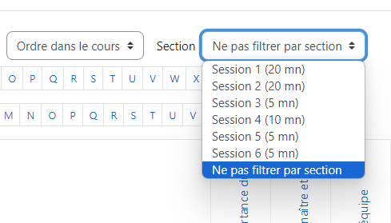
Achèvement d’activités

Slide 39
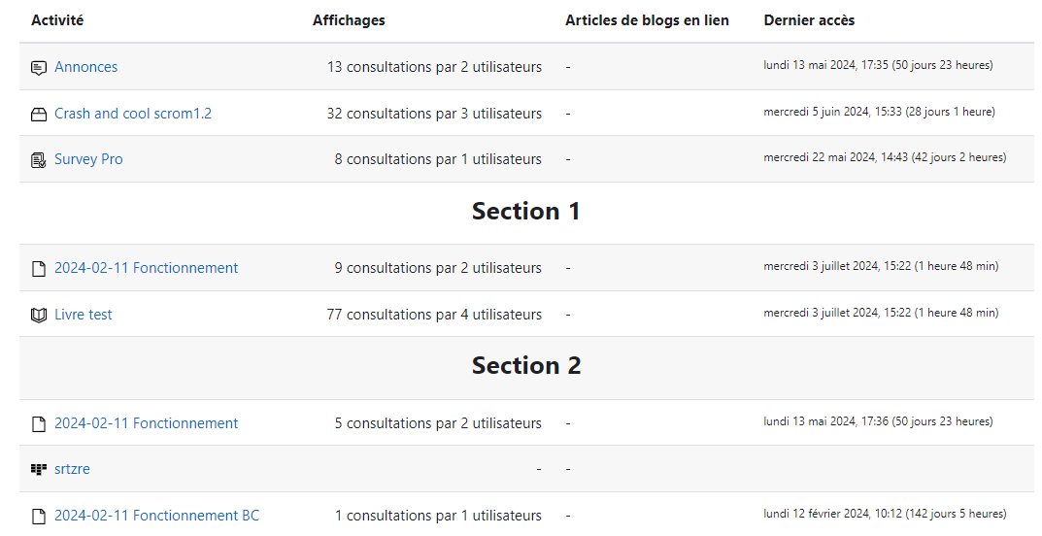
Activités du cours

Slide 40
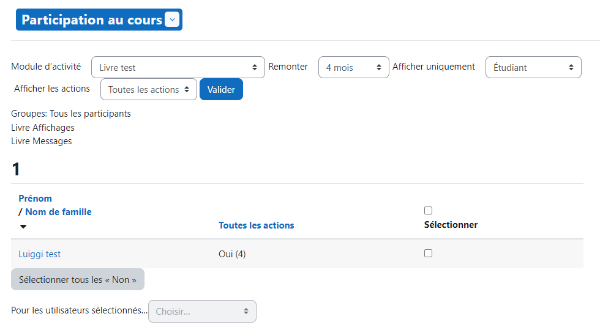
Participation au cours

Slide 41
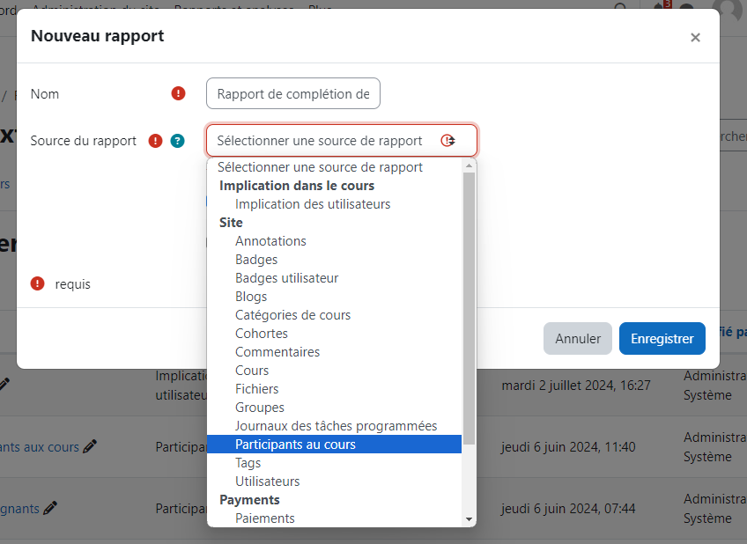
Rapports personnalisés

Slide 42
Rapports personnalisés

Slide 43
Rapports personnalisés

Slide 44
Sources
Liste des tâches
https://moodle.org/plugins/mod_checklist
https://moodle.org/plugins/block_checklist
Super vieo
https://moodle.org/plugins/mod_supervideo
Completion progress
https://moodle.org/plugins/block_completion_progress
Dedication
https://moodle.org/plugins/block_dedication
Grade me
https://moodle.org/plugins/block_grade_me
Point of view
https://moodle.org/plugins/block_point_view

Slide 45
Sources
Assign
https://moodle.org/plugins/report_assign
Course manager
https://moodle.org/plugins/report_coursemanager
Growth
https://moodle.org/plugins/report_growth
Module completion
https://moodle.org/plugins/report_modulecompletion
My feedback
https://moodle.org/plugins/report_myfeedback
Overview statistics
https://moodle.org/plugins/report_overviewstats

Slide 46
Sources
Learning analytics
https://moodle.org/plugins/logstore_lanalytics
https://moodle.org/plugins/local_learning_analytics

